Slide 1
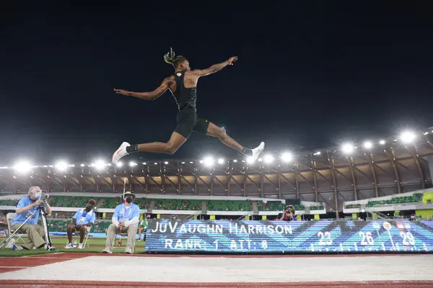
A Machine Learning Based Long Jump Training Assistant
Jacob Sobota

Slide 2
Introduction
The Long Jump is a technical event requiring speed, strength, and precise technique.
Currently, long jump coaching is purely qualitative and up to the coach’s interpretation
Any quantitative work is done at a later date with computers
There are no available applications that offer real-time quantitative analysis of the jump
I propose an application that recognizes important frames and sequences from the long jump, and extracts relevant feature values to be compared to the objective bio-mechanical model

Slide 3
Research Goals
Identify notable positions to measure in the long jump
Identify, code, and extract features to aid in training machine learning models
Build two machine learning models:
One for recognizing touchdown frame
One for recognizing takeoff sequence
Combine ML models with easy-to-use framework to create application

Slide 4
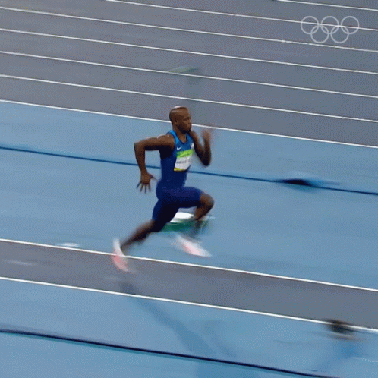
Segments of the Long Jump
Approach run
Takeoff Sequence
Flight
Landing
Jeff Henderson (USA): 2016 Olympic Champion

Slide 5
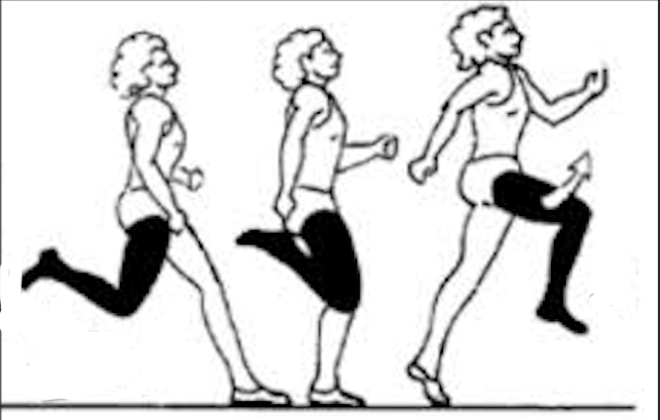
The Takeoff Sequence
Touchdown: The instant the jump foot makes contact with the ground
Takeoff: The instant the jump foot leaves the ground
Takeoff Sequence: The athlete’s movements between touchdown and takeoff.
The athlete’s velocity at takeoff is the greatest predictor of jump distance.
So, what takeoff positions provide the most efficient transfer of speed from touchdown to takeoff?

Slide 6
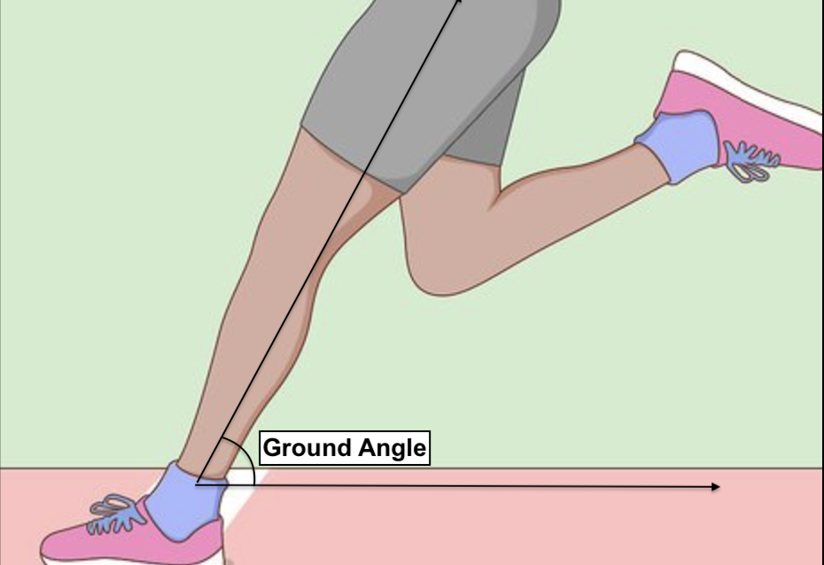
Touchdown Ground Angle
Lees (1994) found the feature most strongly correlated with takeoff speed was the touchdown ground angle
This angle is measured from the hip joint, to the ankle, to the horizontal of the jump leg
Regardless of the athlete’s speed, the optimal touchdown ground angle is between 60 and 70 degrees (Bridgett 2006)

Slide 7
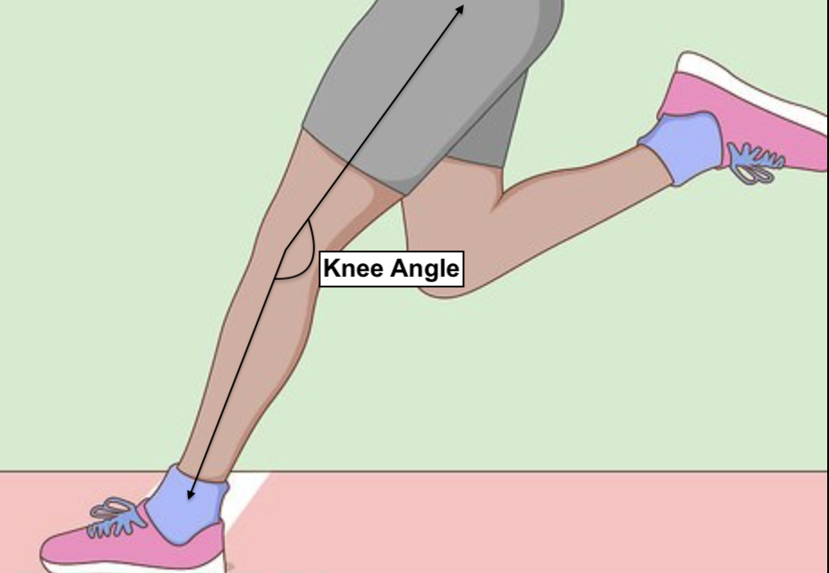
Touchdown Knee Angle
The jump leg receives an enormous amount of force throughout the takeoff
A straighter and stiffer knee handles load better than a bent/collapsed knee
This angle is measured from the jump leg ankle, to knee, to hip
The optimal angle range is between 165-170 degrees

Slide 8
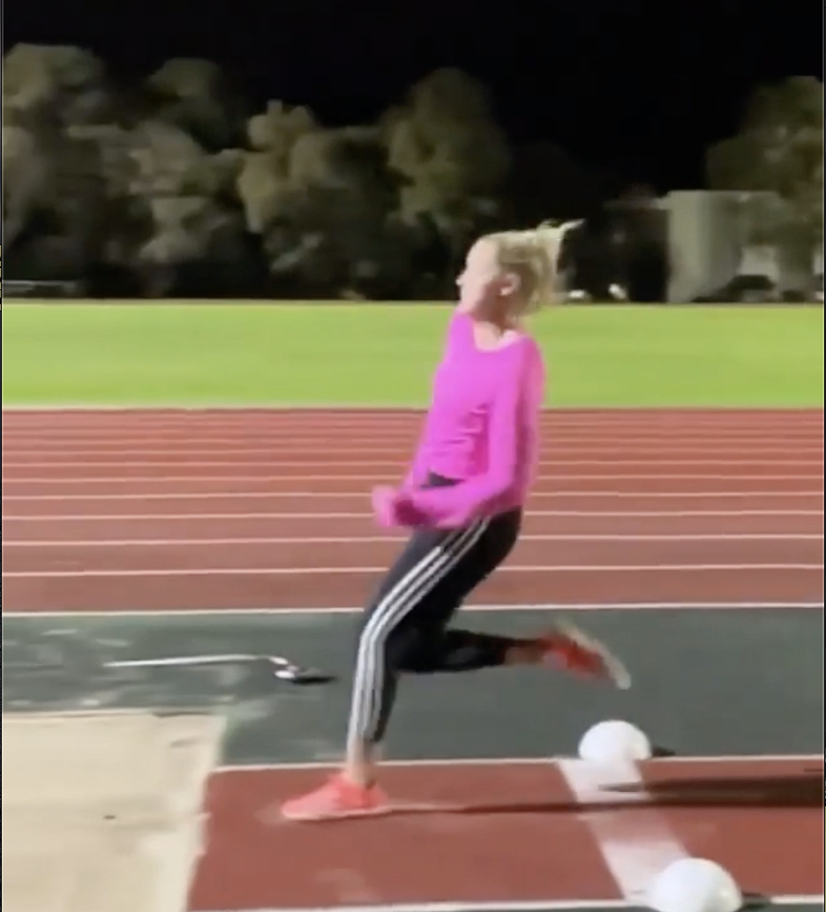
Minimum Knee Angle
No athlete is capable of maintaining their knee angle through the takeoff sequence.
The best athletes will allow their knee angle to decrease as little as possible
Takes place in the middle of takeoff sequence
Alexander (1990) recommends the minimum knee angle should be no less than 135 degrees

Slide 9

Mediapipe Pose Estimation
Open-source software, but developed by Google
Takes a video or image as input
Predicts the location of the most prominent individual’s joints and face features
Returns these predictions as pixel coordinates
These coordinates can be overlayed on top of the image, as seen here.
This is the foundation of the application

Slide 10
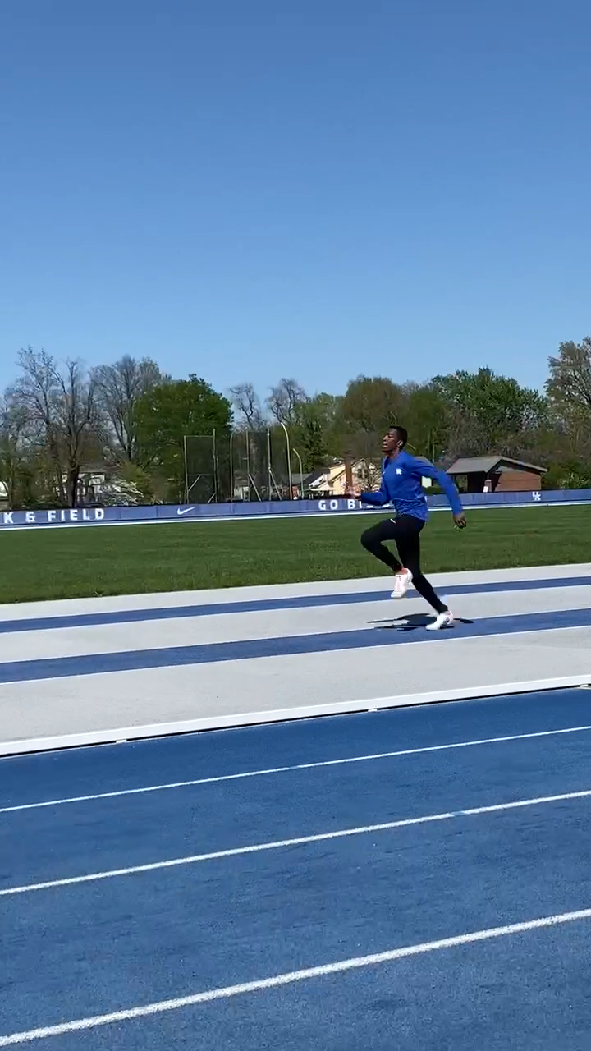
Video Dataset
Robbie Springfield: University of Kentucky Long Jumper
49 videos total
Retrieved from:
University of Kentucky Track and Field
Professional Track and Field Athlete Instagram Accounts
@jumpersworld (Instagram Account)
23 Different Long Jumpers are Represented
All videos meet following criteria

Slide 11


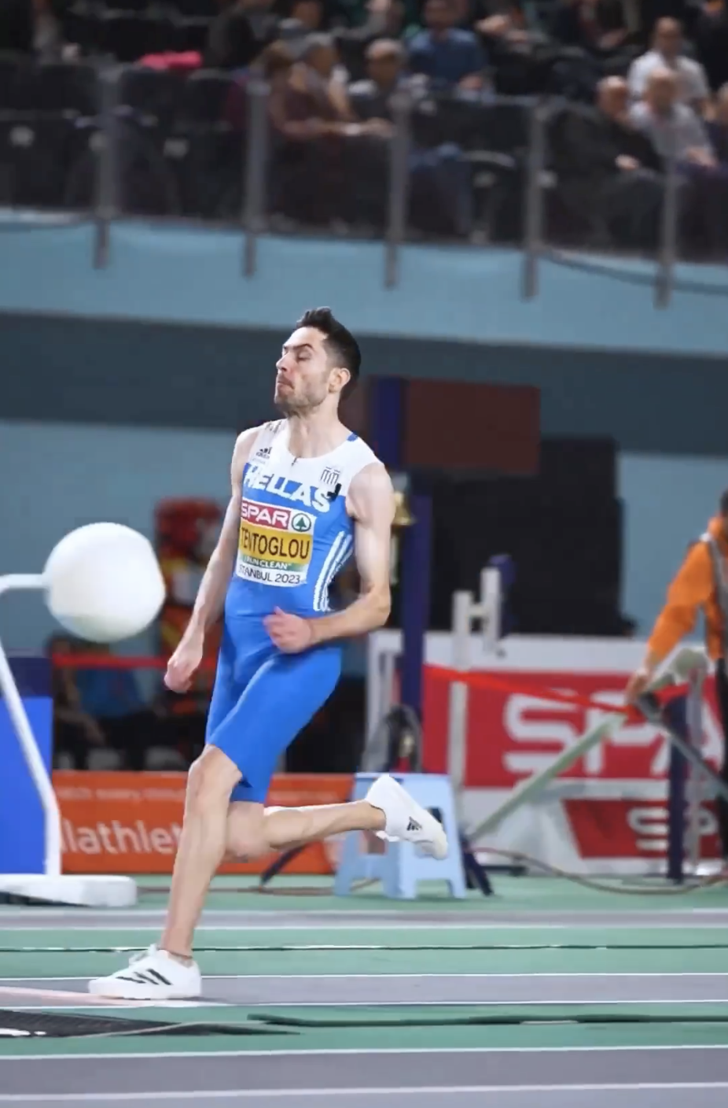
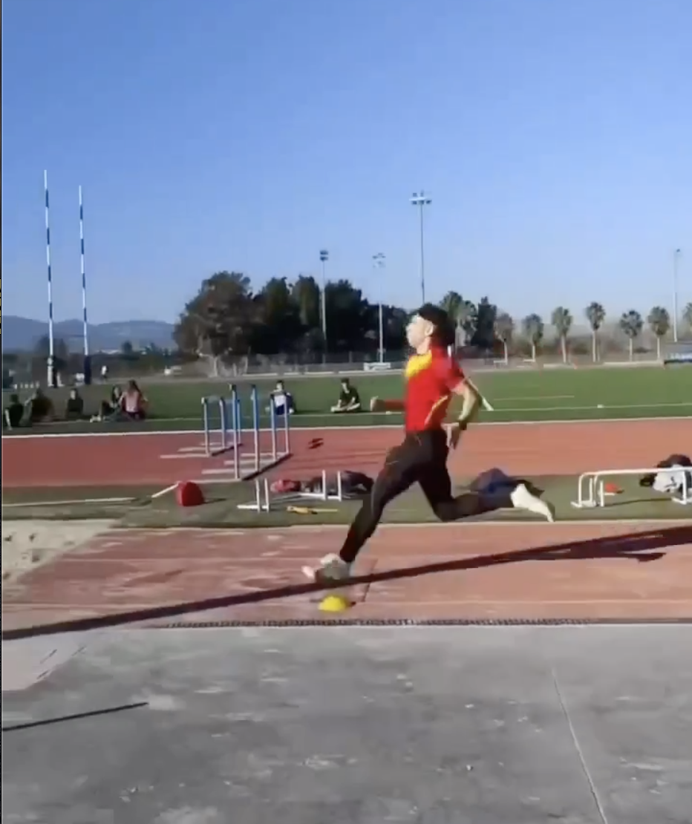
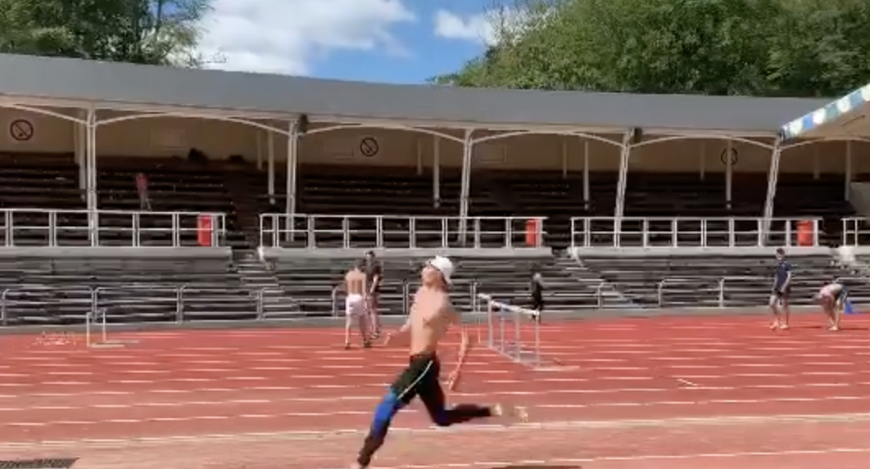
Video Criteria
Cameraman Position: In line with the athlete during the takeoff sequence
Unobstructed View of Athlete: Nothing blocking the athlete during the takeoff sequence
Running to the Left: Athlete is running to the left on film. Videos that did not meet this criteria were horizontally flipped.
Functional with Mediapipe: Mediapipe could accurately predict joints. Only a few videos failed. Otherwise, no restrictions on video quality

Slide 12
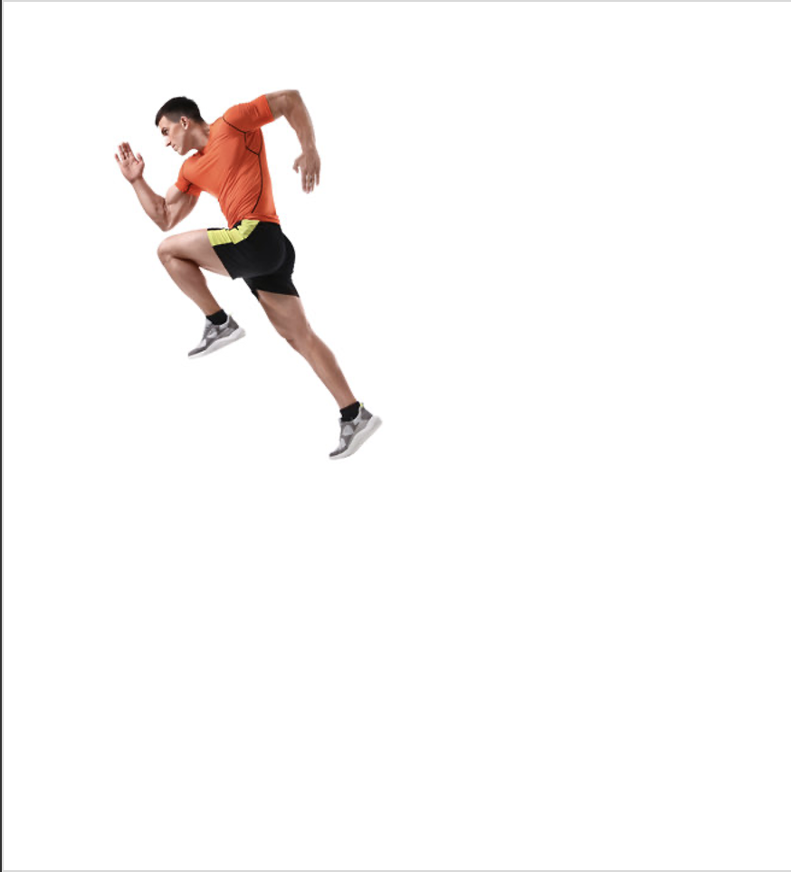
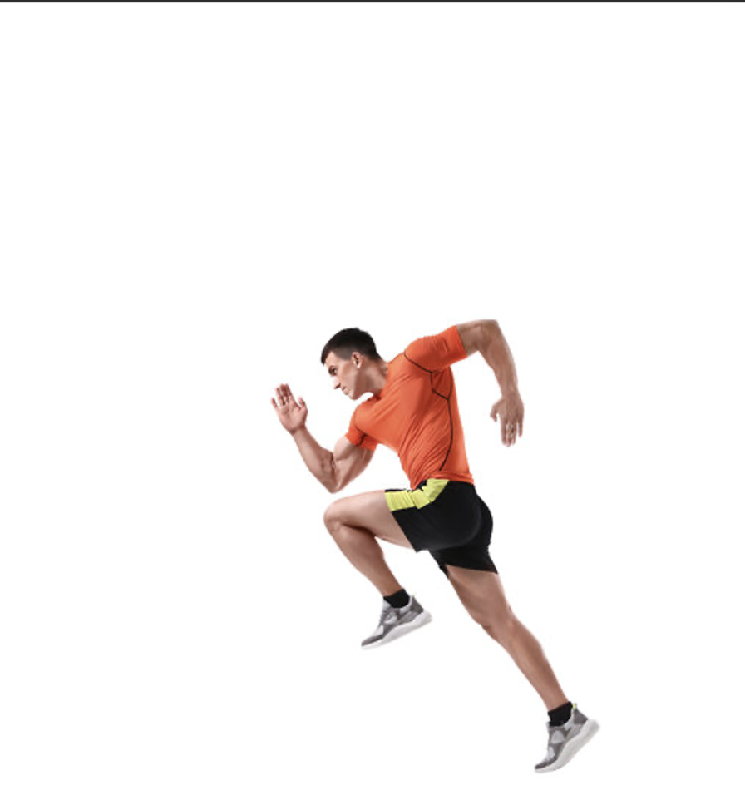
Feature Selection
Mediapipe’s raw coordinate data would return drastically different results for each image.
Must use features that would return the same result from each image
Settled on a combination of limb angles and joint distance ratios
These features are mostly inspired by existing long jump research
These two images each contain the same figure of a runner that has been moved and scaled

Slide 13
Feature | Description | Justification
Right leg knee angle | Angle formed by right ankle, right knee, right hip | This is an angle of interest that informs the quality of takeoff. See Related Work Section. Used by Lees 1994, Seyfarth 2000, Panoutsakopoulos 2010.
Right hip angle | Angle formed by right knee, right hip, right shoulder | This is an angle of interest that informs the quality of takeoff. Used by Lees 1994, Seyfarth 2000, Panoutsakopoulos 2010.
Left leg knee angle | Angle formed by left ankle, left knee, left hip | This is an angle of interest that informs the quality of takeoff. See Related Work Section. Used by Lees 1994, Seyfarth 2000, Panoutsakopoulos 2010.
Left hip angle | Angle formed by left knee, left hip, left shoulder | This is an angle of interest that informs the quality of takeoff. Used by Lees 1994, Seyfarth 2000, Panoutsakopoulos 2010.
Right foot ground angle | Angle formed by right hip, right ankle, and ground (horizontal) | This is an angle of interest that informs the quality of takeoff. Created by adding an invisible point horizontal to the ankle joint. See Related Work section. Used by Lees 1994, Seyfarth 2000, Panoutsakopoulos 2010.
Left foot ground angle | Angle formed by left hip, left ankle, and ground (horizontal) | This is an angle of interest that informs the quality of takeoff. Created by adding an invisible point horizontal to the ankle joint. See Related Work section. Used by Lees 1994, Seyfarth 2000, Panoutsakopoulos 2010.
Ankle Distance / Leg Length | Distance between each ankle divided by left leg length | Measures distance between each ankle joint. The greater this distance, the more likely the athlete is in a touchdown or takeoff position. Not directly utilized in research, but many papers use ankle distance to the hip, and x-coordinate distance between the two ankles. This combines the two into one measure
X distance between right hip and right ankle / right leg length | The x-coordinate distance from right hip to right ankle divided by right leg length | Measures distance of the ankle in front of the hip. When the value is larger, it indicates that the athlete is reaching the foot far out in front of them, which indicates a takeoff. Measured by Lees 1994
X distance between left hip and left ankle / left leg length | The x-coordinate distance from left hip to left ankle divided by left leg length | Measures distance of the ankle in front of the hip. When the value is larger, it indicates that the athlete is reaching the foot far out in front of them, which indicates a takeoff. Measured by Lees 1994
Right and left hip distance / left leg length | Coordinate distance between right and left hip divided by left leg length | Provides information on the relationship between camera and athlete. When hip coordinates are closer to each other, the athlete is likely in line with camera. If they are farther apart, the athlete is likely facing the camera. This was a personal inclusion that helped model performance
Right hip to right wrist distance / right leg length | Distance from right hip to right wrist divided by right leg length | Athletes often reach positions similar to touchdown while cycling their legs in the air post-takeoff. The main difference between these two positions are arm location. At touchdown, wrists are generally near the hip. In flight, at least one wrist is in the air above the head. Helps the model distinguish between the two. This was a personal inclusion that helped model performance
Left hip to left wrist distance / left leg length | Distance from left hip to left wrist divided by left leg length | Athletes often reach positions similar to touchdown while cycling their legs in the air post-takeoff. The main difference between these two positions are arm location. At touchdown, wrists are generally near the hip. In flight, at least one wrist is in the air above the head. Helps the model distinguish between the two. This was a personal inclusion that helped model performance
Forward foot | Indicates which leg is in front based purely on the x-coordinates | This feature helps the model distinguish left and right foot jumps and their common features. This was a personal inclusion that helped model performance
Takeoff foot | Indicates which leg is on bottom based solely on y-coordinates | This feature is more useful in identifying sequences. Provides information to the sequence model on which leg is the takeoff leg as the takeoff ankle will always be the bottom of the two. This was a personal inclusion that helped model performance

Slide 14
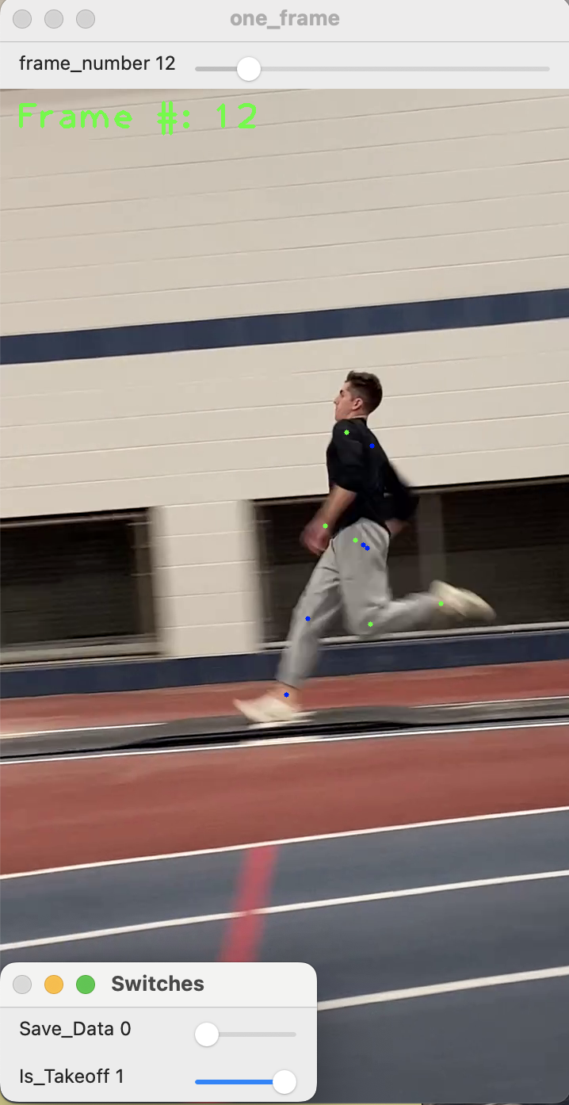
Feature Extraction
Performed manually with the pictured framework in OpenCV using Mediapipe
Left-side joint estimates are green, right side joint estimates are blue
Hidden Python code calculates feature values for each frame
Then, sliders in the bottom left allow for frame labeling and saving feature values to CSV
Each frame had to be saved individually
Each dataset used roughly the same framework
Dataset | Rows | Columns
Touchdown Recognition Dataset | 105 | 15
Takeoff Sequence Recognition Dataset (Frames Only) | 327 | 3
Takeoff Sequence Recognition Dataset (Full Sequences) | 61 | 2

Slide 15
Touchdown Recognition Data
right_knee_angle | right_hip_angle | left_knee_angle | left_hip_angle | right_ground_angle | left_ground_angle | ankle_distance | right_hip_distance | left_hip_distance | hip_distance | right_hand_hip_dist | left_hand_hip_dist | forward_foot | is_touchdown
104 | 112 | 166 | 174 | 86 | 106 | 0.9108 | 0.5132 | -0.1653 | 0.0815 | 0.4216 | 0.7782 | 1 | 0
136 | 204 | 172 | 152 | 159 | 47 | 1.5487 | -0.6910 | 0.7218 | 0.0082 | 0.6215 | 0.5551 | 0 | 0
98 | 199 | 162 | 147 | -168 | 61 | 1.3764 | -0.6576 | 0.5988 | 0.0525 | 0.6448 | 0.1002 | 0 | 1
153 | 205 | 143 | 126 | 152 | 61 | 1.4731 | -0.7282 | 0.6925 | 0.0217 | 0.7859 | 0.4551 | 0 | 0
135 | 145 | 55 | 132 | 106 | 171 | 0.5363 | 0.0552 | -0.1349 | 0.0476 | 0.5040 | 0.0731 | 1 | 0
102 | 201 | 164 | 148 | -169 | 61 | 1.4304 | -0.6982 | 0.5848 | 0.0150 | 0.4168 | 0.2931 | 0 | 1
142 | 208 | 153 | 127 | 164 | 54 | 1.5478 | -0.7870 | 0.7321 | 0.0257 | 0.4923 | 0.4547 | 0 | 0

Slide 16
Touchdown Recognition Model
Performed Z-score Normalization on the angle values of this dataset
Uses Gaussian Naïve Bayes machine learning Model (Scikit-Learn)
Classifier
Probabilistic
Effective for small datasets
Using a 70/30 train/test split, achieved 80%-91% test accuracy with different random seeds
The model used in the application was trained on all 105 datapoints

Slide 17
Takeoff Sequence Recognition Raw Data
Frame Features | Video Number | Class Label
[143, 133, 54, 154, 84, -161, 0.9137625897991168, 0.37861068360312666, -0.29711697999255643, 0.07618384102373242, 0.22969143798832742, 0.3836520204249679, 1, 1] | 3 | Running
[135, 145, 55, 132, 106, 171, 0.5363333904215749, 0.05522870898473681, -0.13487563949833123, 0.04760316688176396, 0.5040343959435514, 0.07314658556239256, 1, 1] | 3 | Running
[125, 152, 76, 110, 131, 129, 0.45784197506534824, -0.24957010215164926, 0.17214589115901327, 0.03657396909185952, 0.6871624923856804, 0.19246495733941688, 0, 1] | 3 | Running
[132, 174, 109, 110, 147, 90, 0.9792095347888339, -0.5106181882516534, 0.4833115378189281, 0.04813420645316375, 0.7845727999536309, 0.3504223124123475, 0, 1] | 3 | Running
[98, 199, 162, 147, -168, 61, 1.3764305018531278, -0.657594467096523, 0.5988448940217928, 0.0525259835555807, 0.644844925638734, 0.10023396564537061, 0, 0] | 3 | Takeoff
[65, 169, 142, 148, -166, 89, 0.9538851837998036, -0.4044149547959074, 0.3123971725361309, 0.052066195422688484, 0.38656283366932565, 0.33955228814599425, 0, 0] | 3 | Takeoff
[46, 137, 138, 156, 176, 109, 0.6700000489660961, -0.15017621388797545, 0.0, 0.08409543714999052, 0.07613643141146119, 0.6622119038703979, 0, 0] | 3 | Takeoff
[62, 110, 168, 181, 131, 111, 0.7409835615738265, 0.15067980605460743, -0.2743563722782319, 0.05647124003834986, 0.24925997628704605, 0.8185139667003865, 1, 0] | 3 | Takeoff

Slide 18
Takeoff Sequence Recognition Training Data
Numeric Class Label | Features
0 | [[130, 132, 89, 193, 72, -161, 1.300377131790072, 0.6121206839237116, -0.6075173213135778, 0.07942929939034747, 1.1063221224934636, 0.6935865390311152, 1, 1], [153, 141, 64, 190, 66, -145, 1.2750963789644199, 0.5760350525115393, -0.47088317797067086, 0.09716637005744001, 0.33367700266340883, 0.44970416680792, 1, 1], [173, 162, 48, 181, 67, -145, 1.0312991919031917, 0.4404622187773885, -0.31052839281672173, 0.07573863239432237, 0.0610624375866661, 0.13074515096992181, 1, 1], [169, 172, 41, 170, 81, -157, 0.8676327784902595, 0.22679851419248523, -0.21912347603086565, 0.05959372916099731, 0.04297364923721788, 0.25673764240296637, 1, 1]]
0 | [[143, 133, 54, 154, 84, -161, 0.9137625897991168, 0.37861068360312666, -0.29711697999255643, 0.07618384102373242, 0.22969143798832742, 0.3836520204249679, 1, 1], [135, 145, 55, 132, 106, 171, 0.5363333904215749, 0.05522870898473681, -0.13487563949833123, 0.04760316688176396, 0.5040343959435514, 0.07314658556239256, 1, 1], [125, 152, 76, 110, 131, 129, 0.45784197506534824, -0.24957010215164926, 0.17214589115901327, 0.03657396909185952, 0.6871624923856804, 0.19246495733941688, 0, 1], [132, 174, 109, 110, 147, 90, 0.9792095347888339, -0.5106181882516534, 0.4833115378189281, 0.04813420645316375, 0.7845727999536309, 0.3504223124123475, 0, 1]]
This table shows two full sequences and their class labels

Slide 19
Takeoff Sequence Recognition Model
Max sequence length was set to 5 frames
All sequences were either padded or cut to length of 5
Using a 70/30 train/test split, achieved 84%-95% accuracy on the test data with different random seeds
The application model was trained on all 61 datapoints
Uses a Keras Sequential model with 3 layers.
Layer 1: LSTM with 64 nodes
Layer 2: LSTM with 16 nodes
Layer 3: Dense layer. Softmax function that helps assign the class
Utilizes “Adam” optimizer
Notes:
Keras is an open-source neural network library written in Python. It is designed to be user-friendly, modular, and extensible, which makes it easy to use for both beginners and advanced users. Keras provides a high-level API for building and training deep learning models. It can run on top of various backends, including TensorFlow, Theano, and Microsoft Cognitive Toolkit (CNTK).
LSTMs (Long Short-Term Memory networks) are a type of recurrent neural network architecture that is designed to capture long-term dependencies and context in sequential data. In the context of video data, LSTMs can be used to model the temporal relationships and dependencies between the frames of a video sequence.
LSTMs are particularly useful for video data because they can effectively handle input sequences of varying lengths and store information for long periods of time. This is important in video data analysis because video sequences can vary in length and can contain complex and subtle temporal patterns that are difficult to capture using traditional machine learning approaches.
In machine learning, the softmax activation function is commonly used in the output layer of a neural network for multi-class classification tasks. It is a type of activation function that takes a vector of arbitrary real-valued inputs and transforms them into a vector of probabilities that sum to one.

Slide 20
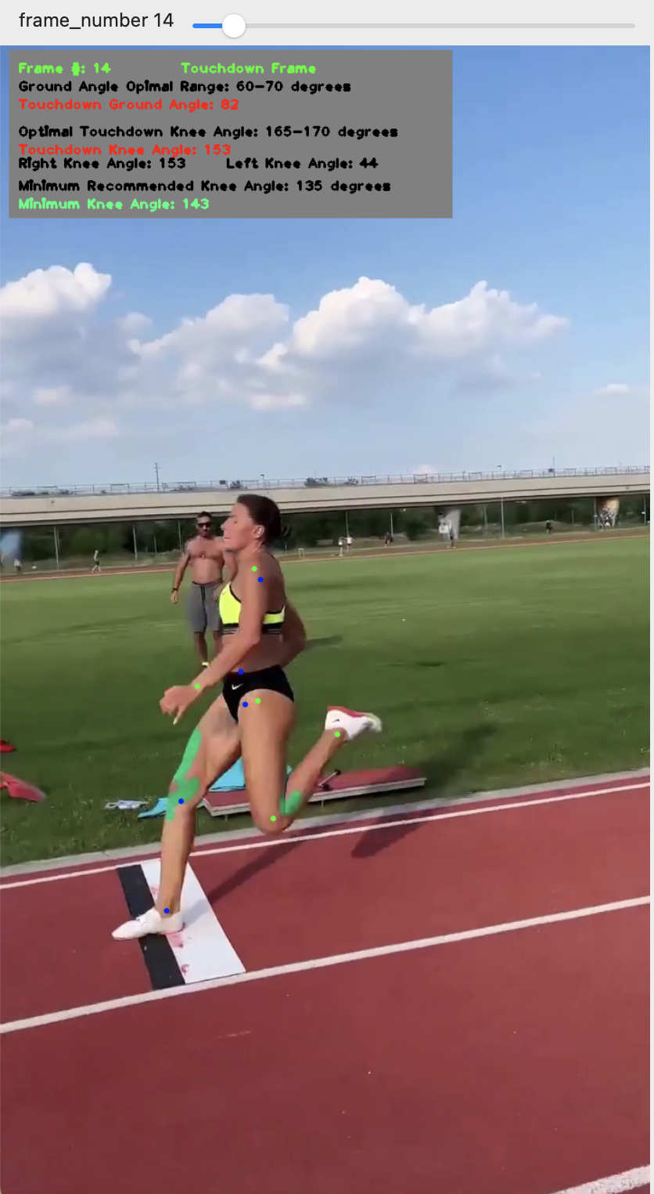
Application Build
Allows user to cycle through frames
Displays observed touchdown ground angle, touchdown knee angle, and takeoff sequence minimum knee angle
Color coded based on whether they are in range of optimal degree values.
Displays indicator for whether user is on a touchdown frame
Displays the knee angles of the current frame

Slide 21
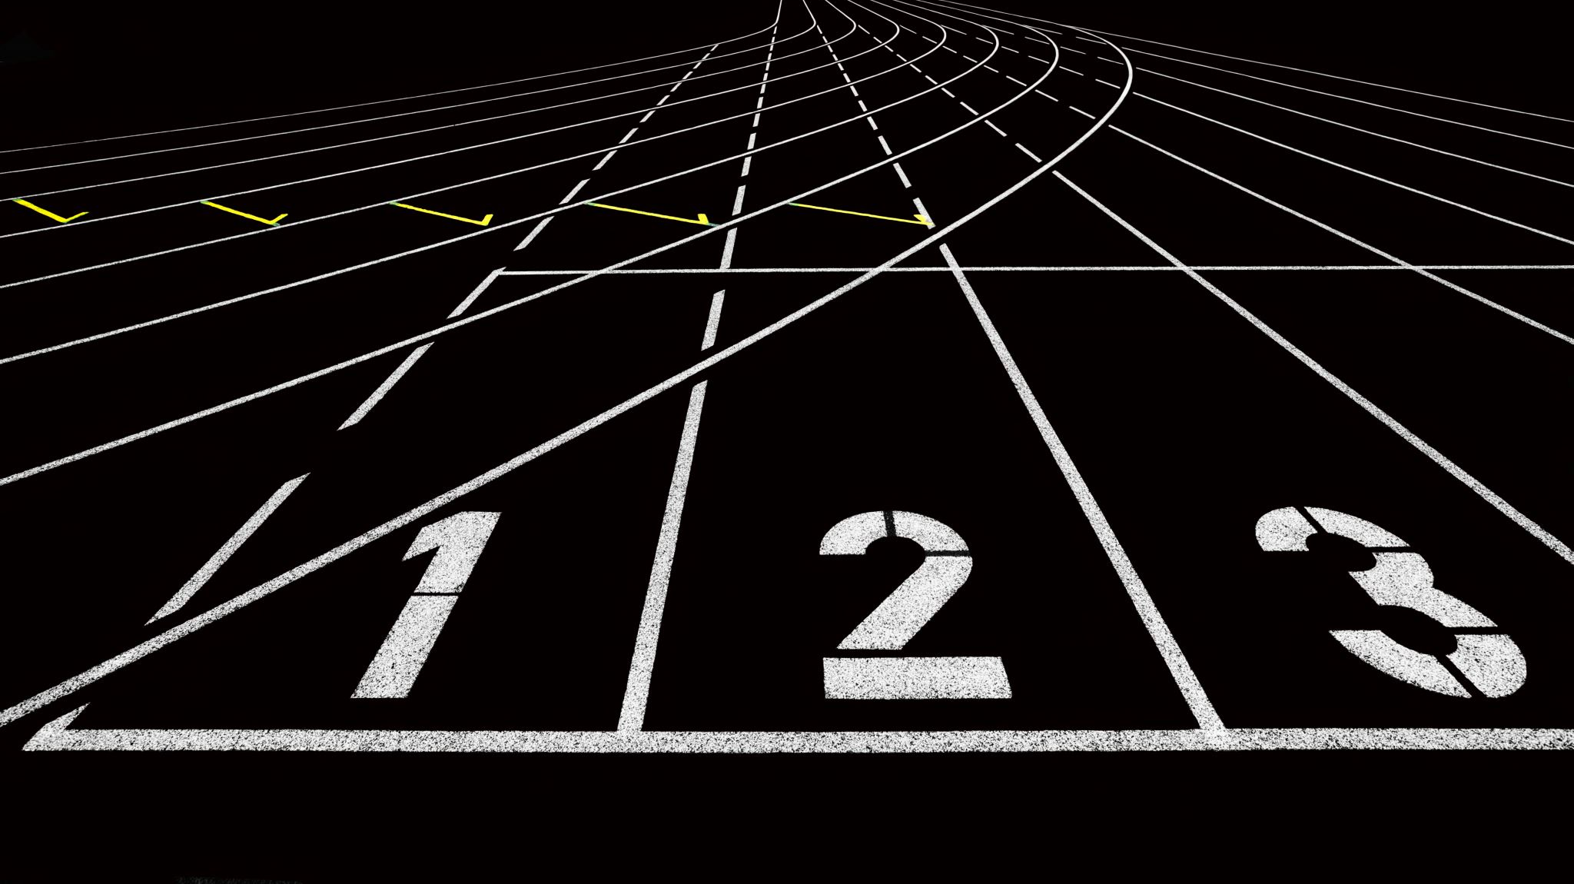
Application Demo

Slide 22
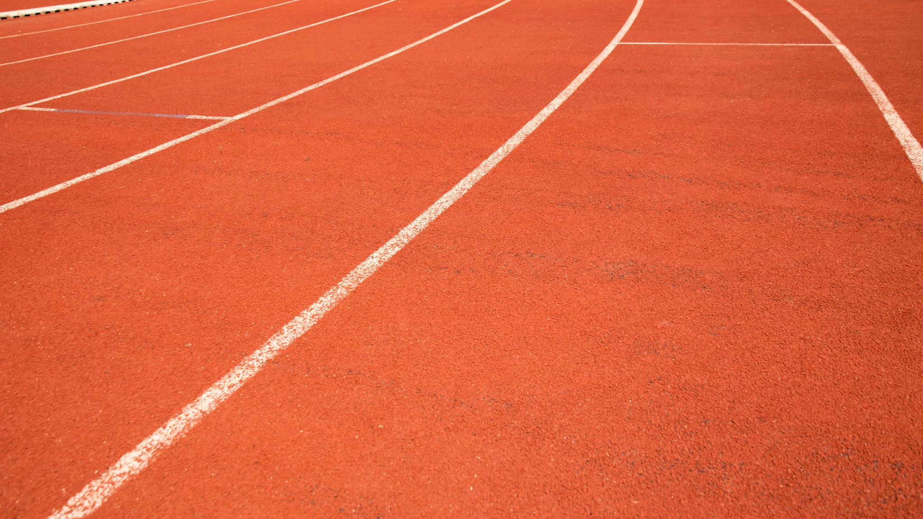
Significance
There are no current applications like this in track and field
First system to offer real-time quantitative feedback
Can inform both technical training and strength training through tracking feature values over time
Bridge the gap in technology access between amateur and professional coaches
Provides a technological stepping-stone for use in other T&F events
Sprinting
Pole Vaulting

Slide 23
Future Work
Implement pose estimation software that models joint positions in 3D space
Eliminates need for cameraman to be in-line with takeoff
More accurate angle measurements
Would allow for training each model on more data
Experiment with different features/feature extractors
Try deep learning
Feature selection techniques
Look into existing pose estimation feature extractors
Measure additional data points
Takeoff efficiency: Measure speed at touchdown and at takeoff just from video
Angle velocities

Slide 24
References
Lees, A., Fowler, N., & Derby, D. (1993). A biomechanical analysis of the last stride, touch-down and take-off characteristics of the women's long jump. Journal of sports sciences, 11(4), 303–314. https://doi.org/10.1080/02640419308730000
Alexander, R.M. (1990). Optimum take-off techniques for high and long jumps. Philosophical transactions of the Royal Society of London. Series B, Biological sciences, 329 1252, 3-10 .
Bridgett, Lisa & Linthorne, Nicholas. (2006). Changes in long jump take-off technique with increasing run-up speed. Journal of sports sciences. 24. 889-97. 10.1080/02640410500298040.
Panoutsakopoulos, Vassilios & Papaiakovou, Georgios & Katsikas, Fotios & Kollias, Iraklis. (2010). 3D Biomechanical Analysis of the Preparation of the Long Jump Take-Off. New studies in athletics. 25. 55-68.
Linthorne, Nick. “ Optimum Take-Off Angle in the Long Jump.” Long Jump Optimum Take-off Angle, https://www.brunel.ac.uk/~spstnpl/BiomechanicsAthletics/LJOptimumAngle.htm#:~:text=The%20optimum%20take%2Doff%20angle%20for%20the%20athlete%20is%20obtained,%C2%B0%2C%20but%20about%2022%C2%B0.
Google. (2021). Mediapipe: A framework for building multimodal (cross, face, hand, iris) applied machine learning pipelines. https://google.github.io/mediapipe/solutions/pose.html
OpenCV. (2021). OpenCV: Open Source Computer Vision Library. https://opencv.org/
Pedregosa, F., Varoquaux, G., Gramfort, A., Michel, V., Thirion, B., Grisel, O., Blondel, M., Prettenhofer, P., Weiss, R., Dubourg, V., Vanderplas, J., Passos, A., Cournapeau, D., Brucher, M., Perrot, M., & Duchesnay, É. (2011). Scikit-learn: Machine learning in Python. Journal of Machine Learning Research, 12, 2825-2830. https://jmlr.csail.mit.edu/papers/volume12/pedregosa11a/pedregosa11a.pdf
Abadi, M., Barham, P., Chen, J., Chen, Z., Davis, A., Dean, J., Devin, M., Ghemawat, S., Irving, G., Isard, M., Kudlur, M., Levenberg, J., Monga, R., Moore, S., Murray, D., Steiner, B., Tucker, P., Vasudevan, V., Warden, P., ... & Zheng, X. (2016). TensorFlow: A system for large-scale machine learning. In Proceedings of the 12th USENIX Symposium on Operating Systems Design and Implementation (OSDI'16) (pp. 265-283). USENIX Association. https://www.usenix.org/system/files/conference/osdi16/osdi16-abadi.pdf
Chollet, F., & Keras Team. (n.d.). Video classification with pre-trained models. Keras. Retrieved April 13, 2023, from https://keras.io/examples/vision/video_classification/
Pedregosa, F., Varoquaux, G., Gramfort, A., Michel, V., Thirion, B., Grisel, O., Blondel, M., Prettenhofer, P., Weiss, R., Dubourg, V., Vanderplas, J., Passos, A., Cournapeau, D., Brucher, M., Perrot, M., & Duchesnay, É. (2011). Naive Bayes. scikit-learn. Retrieved April 13, 2023, from https://scikit-learn.org/stable/modules/naive_bayes.html

Slide 25
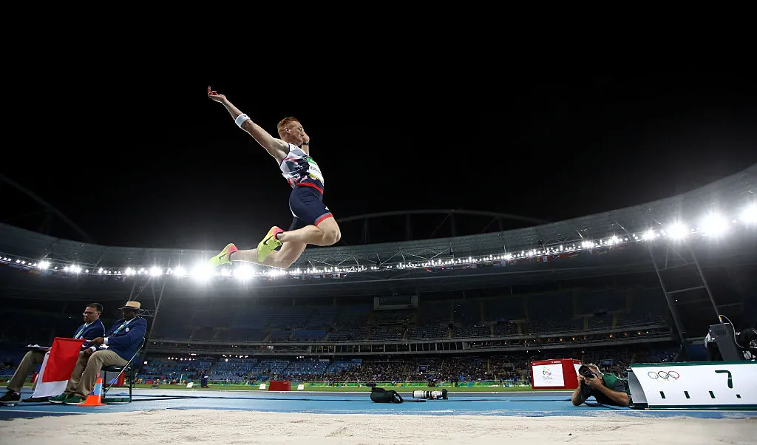
Questions

